Slide 1
Global Warming & Green House effect
Name : Hiren Y. Gohil
En. No: 160410116037
Guided By: Disha Patel

Slide 2
What is Global Warming?
Global warming, also referred to as climate change, is the observed century-scale rise in the average temperature of the earth's climate system and its related effects. Multiple lines of scientific evidence show that the climate system is warming.

Slide 3
Future climate change and associated impacts will differ from region to region around the globe. Anticipated effects include increasing global temperatures, rising sea levels, changing precipitation, and expansion of deserts in the subtropics.
In the period from 1880 to 2012, the global average (land and ocean) surface temperature has increased by 0.85 [0.65 to 1.06] °C, multiple independently produced datasets confirm. In the period from 1906 to 2005, Earth's average surface temperature rose by 0.74±0.18 °C. The rate of warming almost doubled in the last half of that period

Slide 4
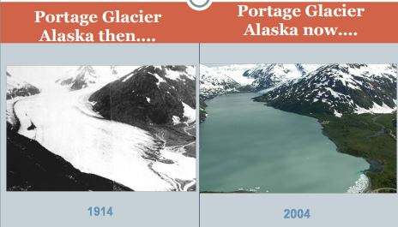
Some Proof of Global Warming

Slide 5
What is Greenhouse effect?
The greenhouse effect is a natural process that warms the Earth's surface. When the Sun's energy reaches the Earth's atmosphere, some of it is reflected back to space and the rest is absorbed and re-radiated by greenhouse gases.

Slide 6
If a planet's atmosphere contains radiatively active gases (greenhouse gases) they will radiate energy in all directions. Part of this radiation is directed towards the surface, warming it. The intensity of the downward radiation – that is, the strength of the greenhouse effect – will depend on the atmosphere's temperature and on the amount of greenhouse gases that the atmosphere contains.

Slide 7
Human activities, primarily the burning of fossil fuels and clearing of forests, have intensified the natural greenhouse effect
By their percentage contribution to the greenhouse effect on Earth the four major gases are
water vapor, 36–70%
carbon dioxide, 9–26%
methane, 4–9%
ozone, 3–7%

Slide 8
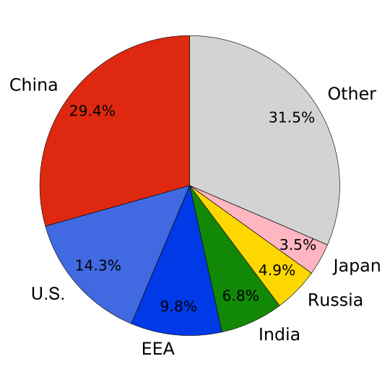
Global carbon dioxide emissions by country.

Slide 9
What is the difference between Global Warming and the Greenhouse Effect?
Global warming refers to a rise in the temperature of the surface of the earth An increase in the concentration of greenhouse gases leads to an increase in the magnitude of the greenhouse effect.

Slide 10
Ways to Stop Global Warming & Green House effect
Plant Trees
Reduce Waste
Use Less Heat and Air Conditioning
Go Solar
Use Less Hot Water
Replace Filters on Air Conditioner and Furnace

Slide 11
Case Study Name: Climate Change study in Uttarakhand - India
The rivers in the region originated from the Himalayan glaciers. Between 2006 and 2008 a series of floods and droughts were experienced with change in the rainfall pattern in the area, that effected crops, animals and people’s livelihoods extensively. 755 persons living in 165 villages in the Garhwal area were interviewed and their evidences were recorded, along with verification of ground truths relating to the climate events in this period by a research team from ‘Navdanya” in 2008-2009

Slide 12
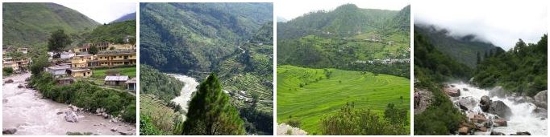
1100 Roads damaged, 94 bridges washed away, 60k+ people stranded and over 150 people killed and this figure is bound to increase as floods have not helped army operations in search of bodies.

Slide 13
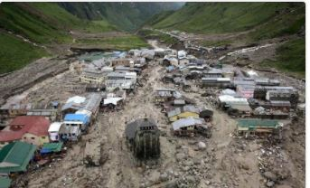

Slide 14
THANK YOU

